Slide 1
MetaMex NFT marketplace platform development on the Elrond blockchain
Vladimir Andrianov
Business Information Technology

Slide 2
Content
Introduction
Web 3.0, Elrond, community platform
Background
NFT market, solutions on ETH, Elrond, competition
MetaMex marketplace
Front-end
Back-end
Smart contract
DevOps
CMS
DAO
Demo
Conclusion
2

Slide 3
Introduction
3

Slide 4
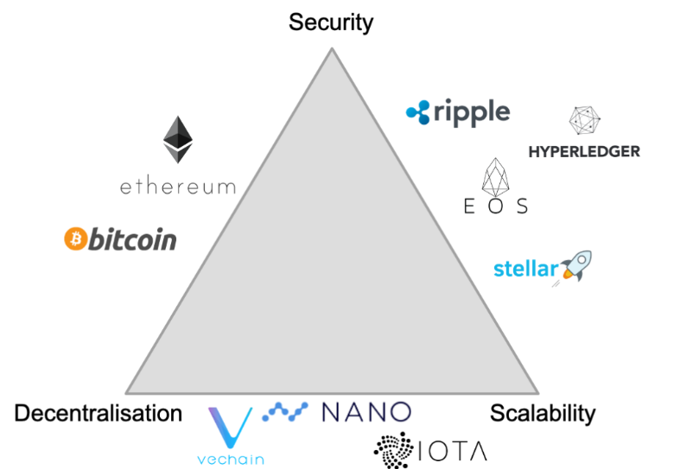


Introduction
Web 3.0
Decentralized
Transparent
Blockchain
Elrond
Third generation blockchain
Secure Proof of Stake
NFT, smart contract support
Community platform
Elrond World
Gokai Labs
Blockchain trilemma [1]
Gokai Lab’s Mr. Ghost collection [2]
Elrond World community logo [3]
4

Slide 5
Background
5

Slide 6
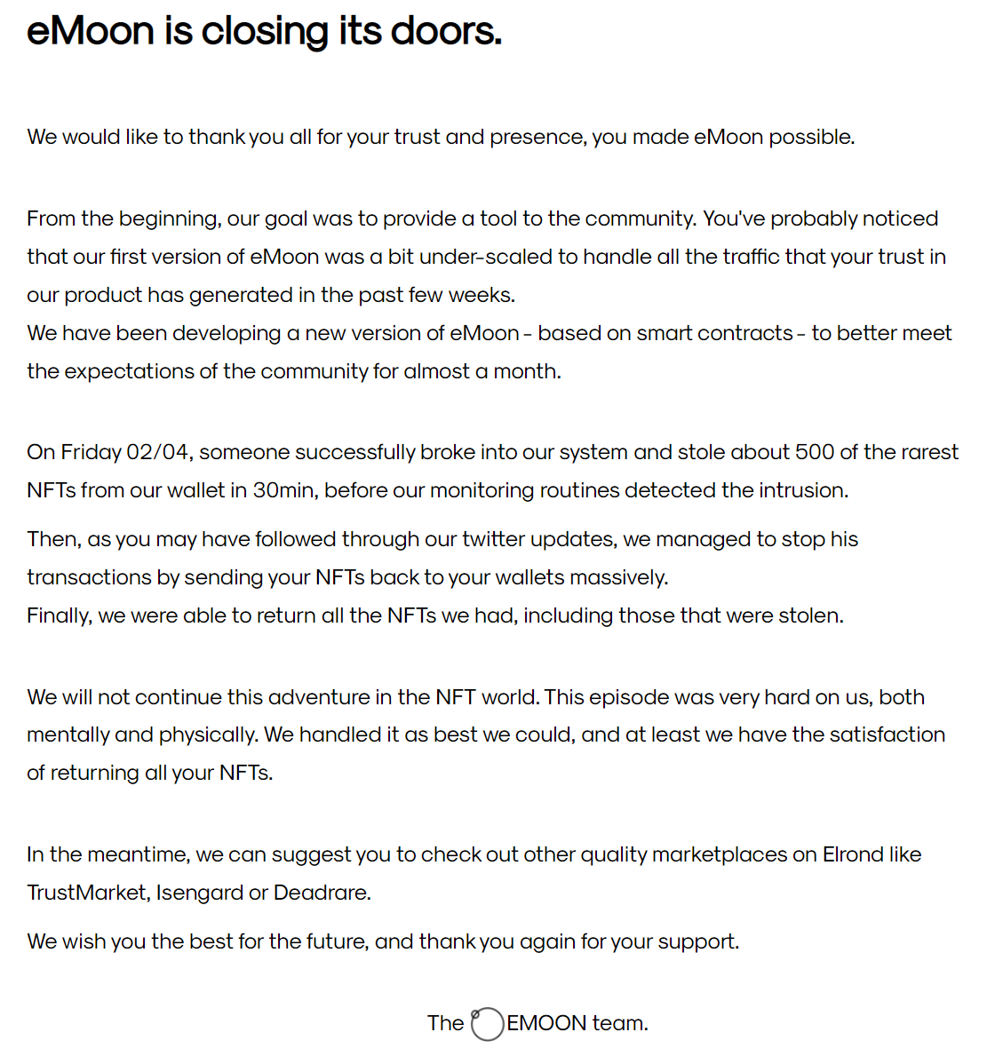
Competition
NFT market
Ethereum
Elrond
Security
competition
Ethereum
OpenSea
Solana
Magic Eden
Elrond
eMoon
eMoon is closing its doors [4]
6

Slide 7
MetaMex marketplace
7

Slide 8
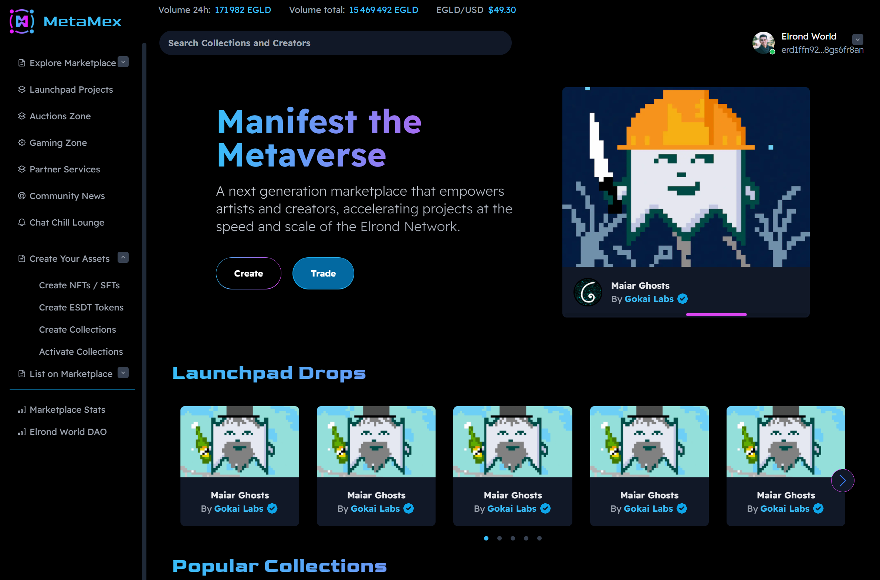
Front-end
Next.js & TypeScript
Wallet integration
Blog
Assets
Launchpad
Drops
DAO
MetaMex main page
8

Slide 9
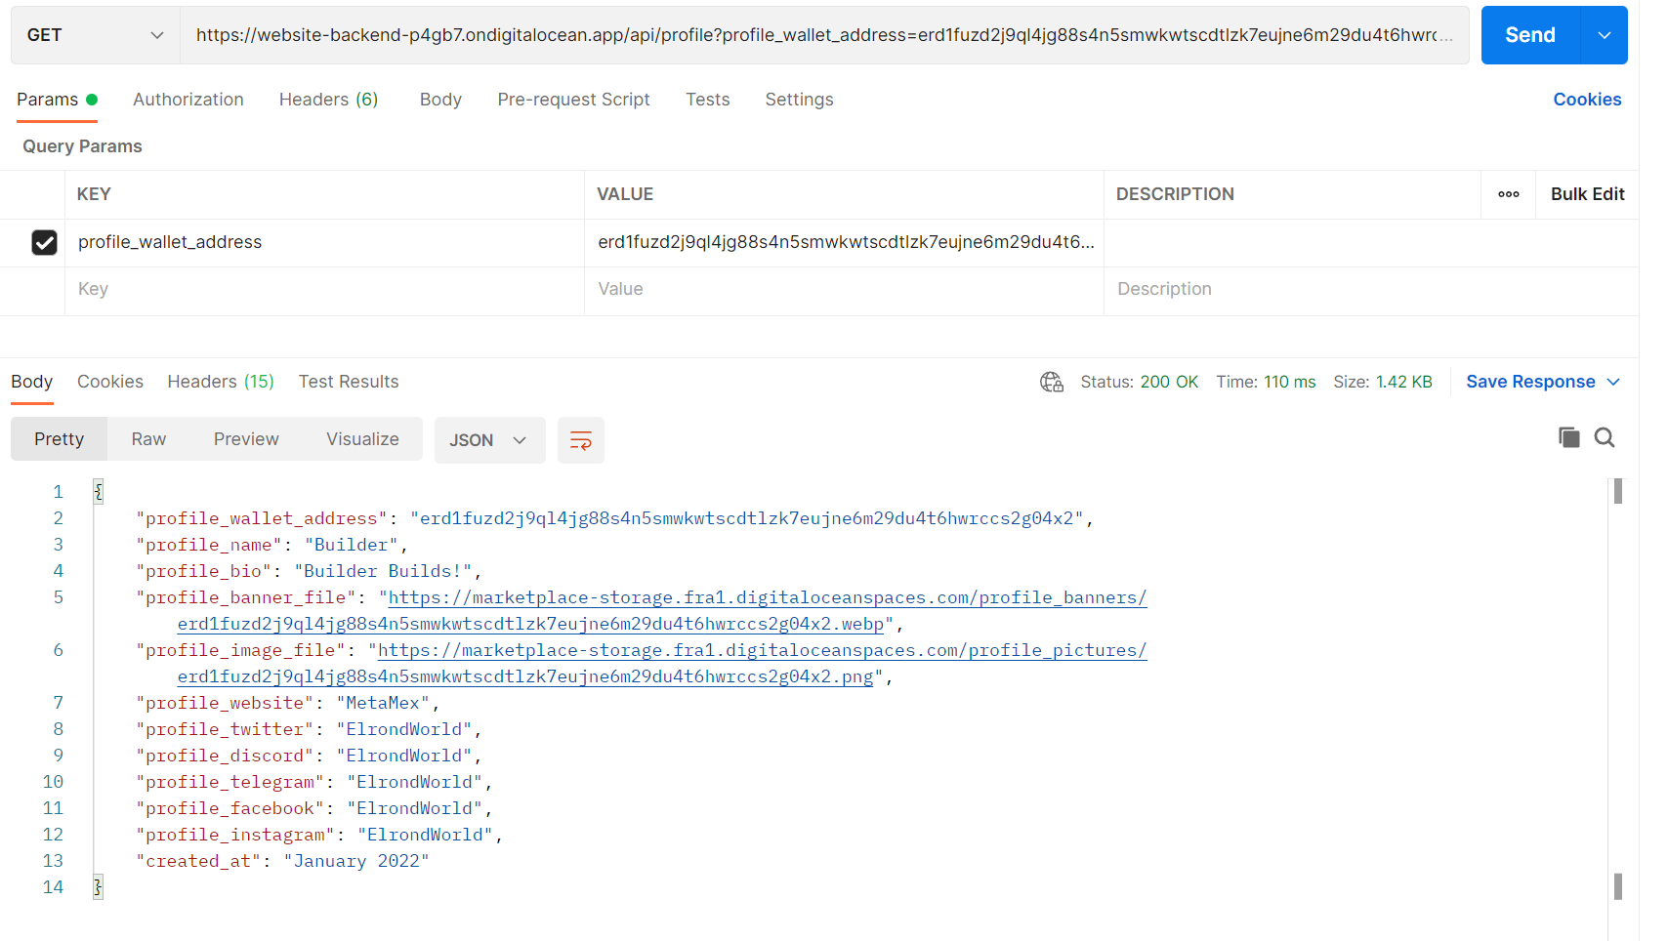
Back-end
Golang
DDD
Profile data
File storage
API
Profile data response
9

Slide 10
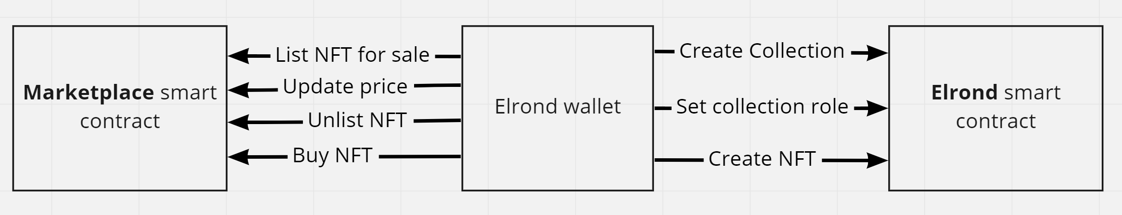
Smart-contract
WASM
Rust
Methods
View functions
Multi smart contract architecture
10

Slide 11
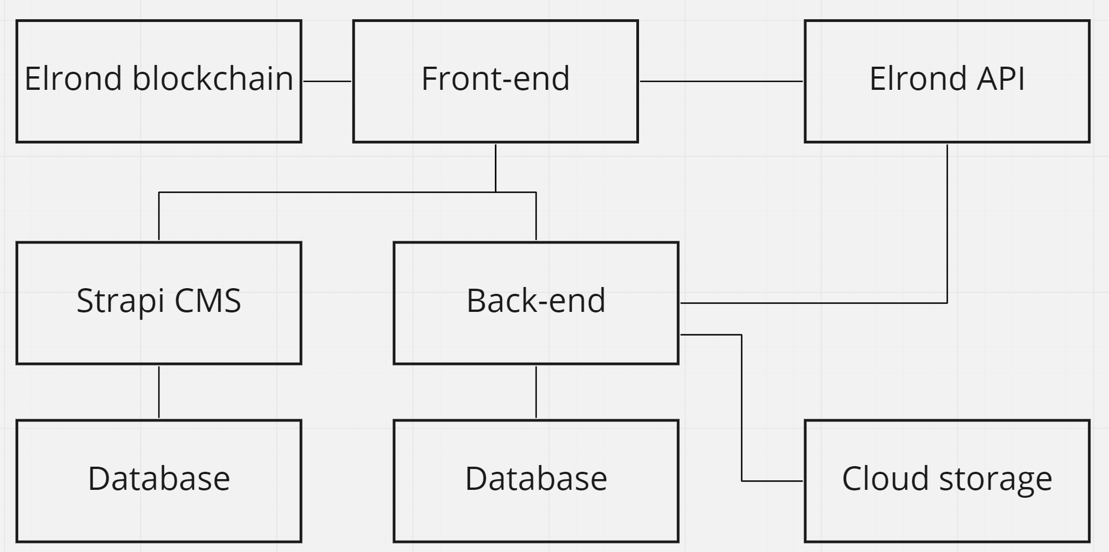
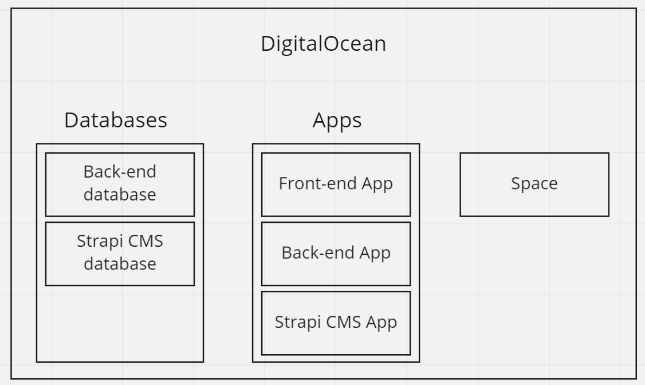
devops
Hybrid Application
Digital Ocean
Apps
Domain
Components
Docker
Space
CDN
Cluster
Managed Database
Hybrid application architecture
DigitalOcean components
11

Slide 12
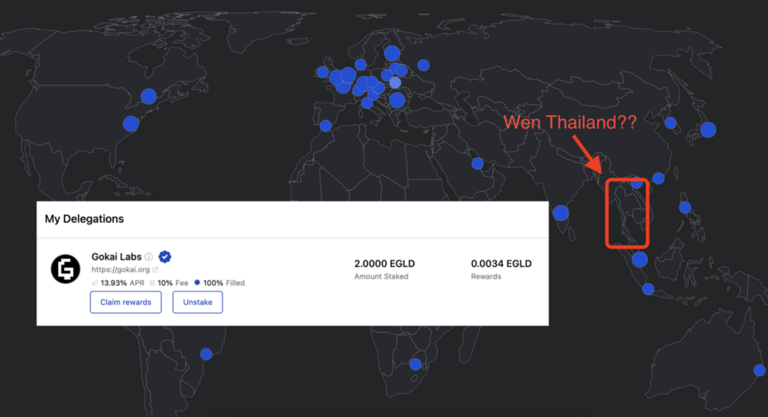
DAO
Decentralized autonomous organization
Distributed team
Europe
Estonia
Romania
Asia
Thailand
Voting
Treasury
Multisignature SC
Gokai Labs Asia initiative [5]
12

Slide 13
Future development
demo
13

Slide 14
Future development DEMO
http://localhost:3000/
14

Slide 15
Conclusion
15

Slide 16
MetaMex transaction fees
Action | Transaction fees
Create collection | Value: $7.15 Fee: $0.1156
Set special role (ESDTNFTCreate) | Value: 0 Fee: $0.1081
Create NFT | Value: 0 Fee: $0.0542
List NFT | Value: 0 Fee: $0.0680
Buy NFT | Value: #NFT_PRICE# Fee: $0.0217
Update listing price | Value: 0 Fee: $0.0247
Cancel listing | Value: 0 Fee: $0.0227
Get listing details | none
Get all listings | none
Fees for ~145$ per EGLD
Elrond built-in functions
Create collection
Set collection role
Create NFT
MetaMex smart contract
List NFT
Buy NFT
Update listing price
Cancel listing
Views
Get listing details (View)
Get all listings (View)
Actions and transaction fees
16

Slide 17
Operational costs
Monthly infrastructure costs: 35$
Incl. 20% VAT: 42$
Space overages
$0.02/GB storage and $0.01/GB bandwidth
Managed Database overages
Price grows with higher-tier clusters
17

Slide 18
Conclusion
Web 3.0 marketplace
Community platform
Secure & innovative EU blockchain project
Efficient smart contracts
Full-stack development and team work
DAO
Distributed team
Future development
Marketing package
Beginner artists support
MEX, ESDT tokens integration
Staking provider
18

Slide 19
references
Blockchain Trilemma. Grodzicka, H. (22.07.2020) [WWW] https://blog.fingo.pl/blockchain-trilemma/ (26.05.2022).
Mr Ghost Elrond NFT around the Maiar logo. Gokai Labs (04.04.2022) [WWW] https://medium.com/@GokaiLabs/gokai-labs-mr-ghost-elrond-nft-around-the-maiar-logo-44bf2099a1ee (26.05.2022).
Elrond World [WWW] https://twitter.com/ElrondWorld (26.05.2022).
eMoon is closing its doors. eMoon [WWW] https://emoon.space/ (26.05.2022).
Stake EGLD to become a validator of the Elrond blockchain. Gokai Labs (28.03.2022) [WWW] https://medium.com/@GokaiLabs/gokai-labs-stake-egld-to-become-validator-of-the-elrond-blockchain-b394d620ded0 (26.05.2022).
19

Slide 20
Acknowledgements
Thesis
Smart contract development
Blockchain platform development
Opportunity
Support
Academic
Personal
Product
20

Slide 21


TALLINN UNIVERSITY OF TECHNOLOGY
taltech.ee/en
21

